Slide 1


DATA221 Intro Machine Learning 12
William Trimble

Slide 2
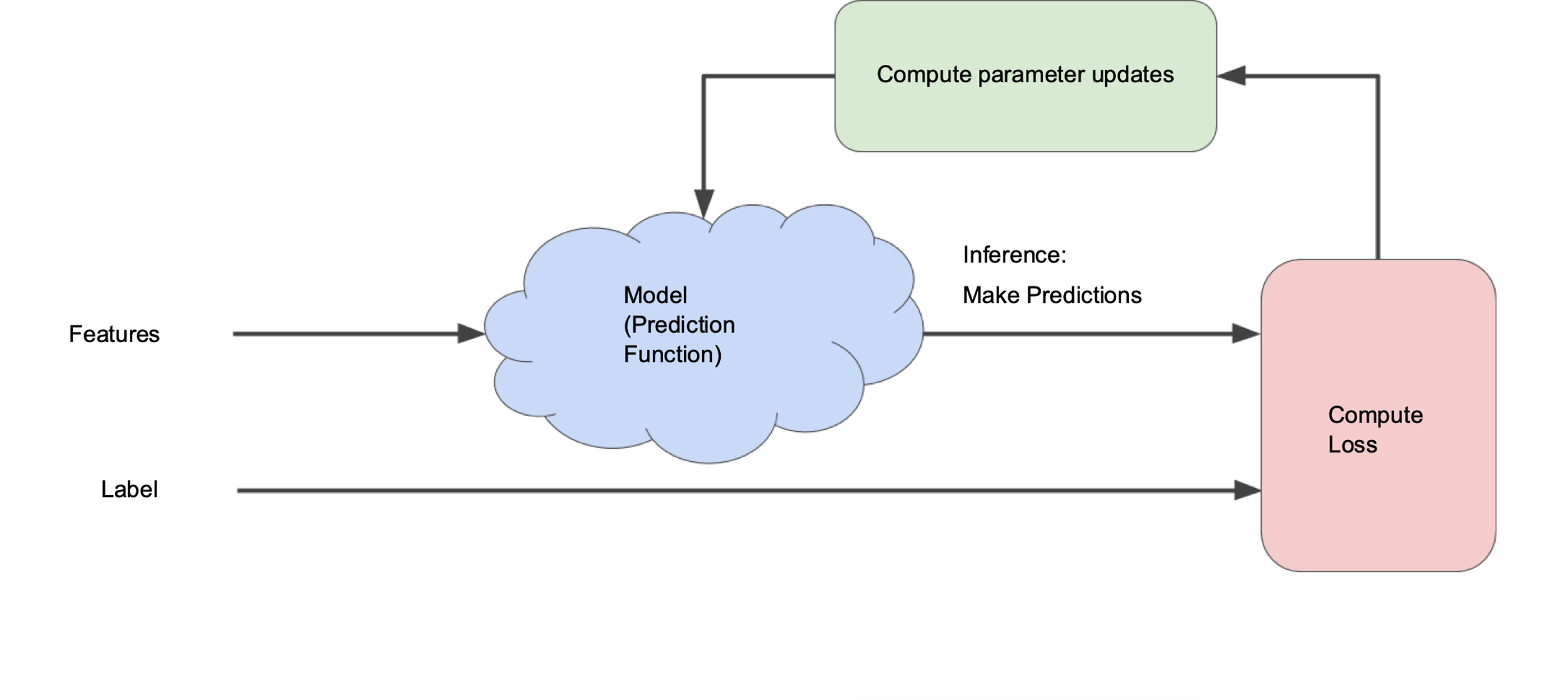
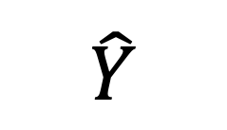
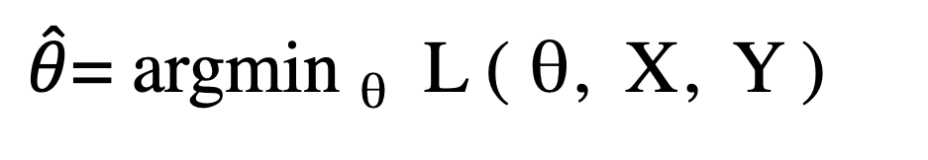
The optimization paradigm
$\hat{θ}$= argmin _{θ} L ( θ, X, Y )
θ
$$\hat{Y}$$
X
Loss
Y

Slide 3
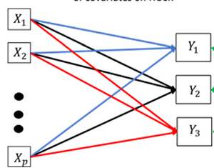
Q
x₁
x₄
x₂
x₃
w₁
w₂
w₃
w₄
Beak length,
mass
Species
inference
n
x₁
x₄
Q
e₁^{T}
y
x₂
x₃
w₁
=
w₂
n
w₃
w₄
(n x p)
(n x r)
(r x p)
X_{r}

Slide 4
Q
x₁
x₄
x₂
x₃
w₁
w₂
w₃
w₄
Features
Class
inference
p classes
r features
p classes
n
x₁
x₄
Q
e₁^{T}
y
x₂
x₃
w₁
=
w₂
n
n samples
w₃
w₄
(n x p)
(n x r)
(r x p)
X_{r}

Slide 5
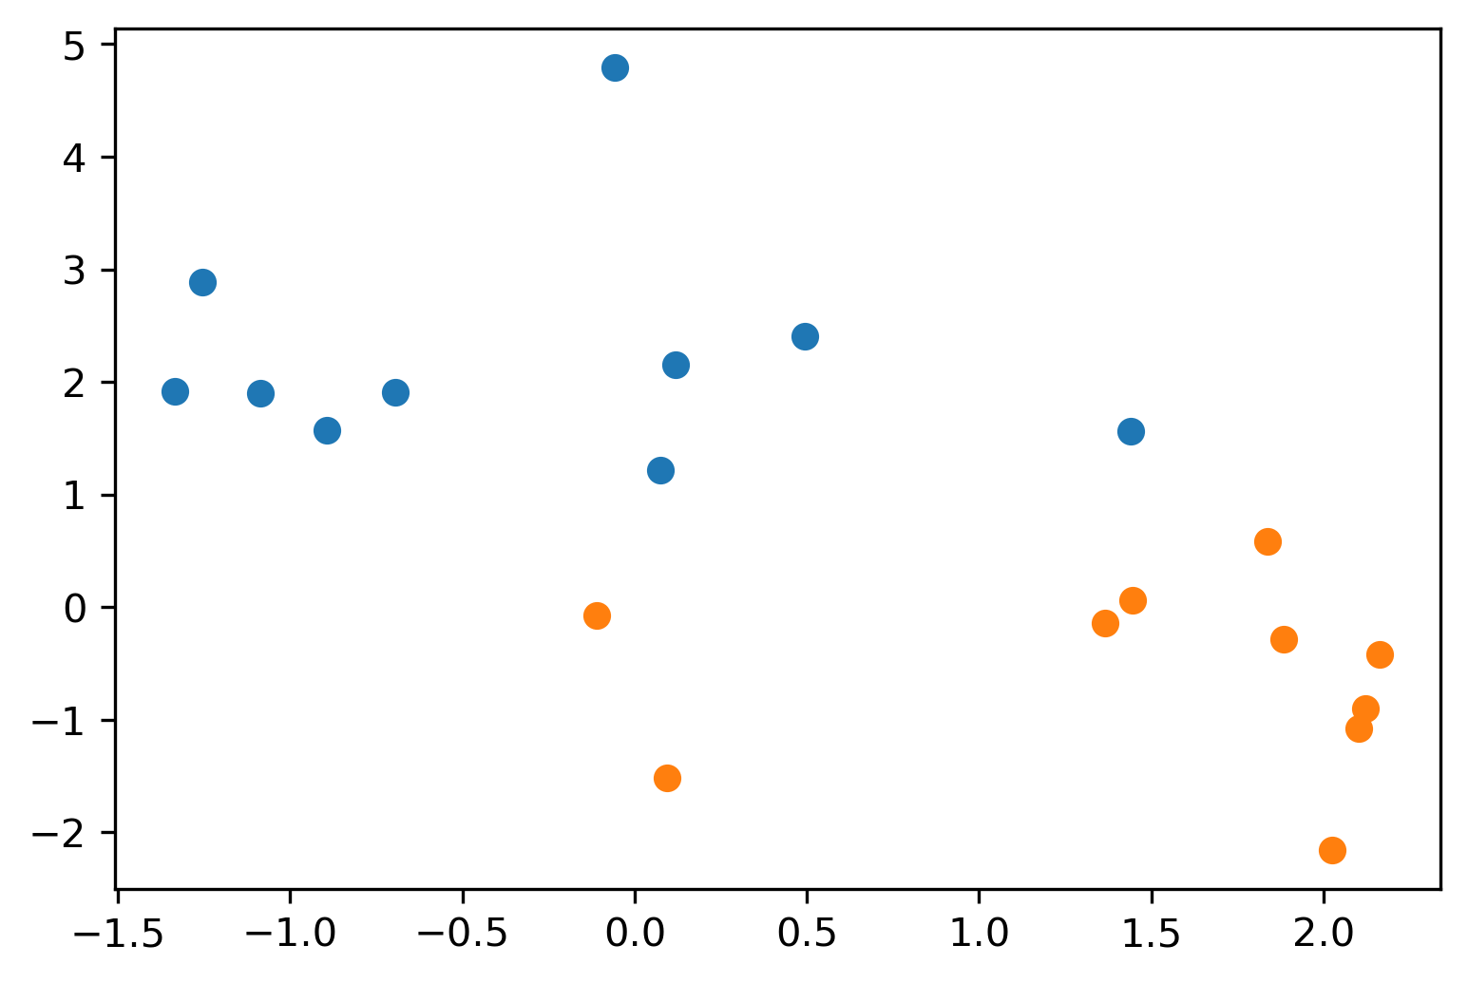
Maximum-margin line of thinking…
There will be a minimum value of the margin that “works” – minimum linear-classification error on the training data

Slide 7
Larger values of the margin will include more points.
Number of points… function of margin parameter

Slide 8
Math elided
The optimization that produces the soft-margin maximum-discrimination line (hyperplane) depends on the training points: features and class identity
Usually doesn’t depend on all of them
Number of points considered depends on margin parameter
Depends on training data only through the values of x_{i} dot x_{j} !!!! (There are n² / 2 of these !!)
In a sense, this looks for “boundary case” examples of the data and trains only using them.

Slide 9
Support Vector Machine
The (limited) set of training points whose geometry is used to find the boundary are called “support vectors;” they support the inference of the position of the boundary.
The rule to combine training examples to construct the boundary can be more elaborate than a separating hyperplane; the function that weights the training data is called the “kernel”
This technique can be adapted to implement fits like logistic regression and fits like KNN classifier.
Trains in a different way; can be very efficient.

Slide 10
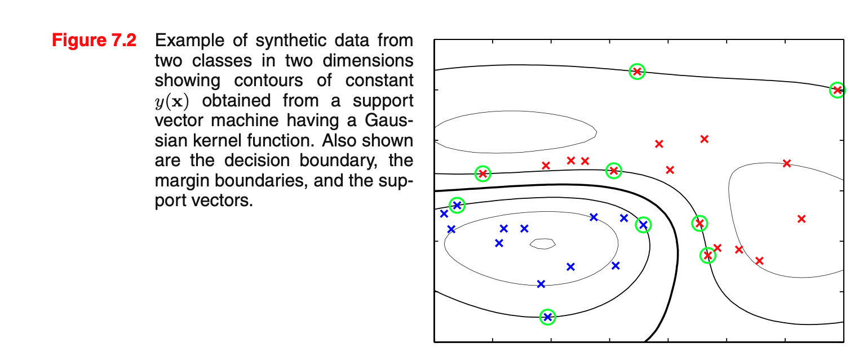
Bishop Pattern Recognition and Machine Learning, Springer, 2006

Slide 11
Inner products all-against-all columns
n
r
r
A^{T}
A
A^{T}A
=
r
r
n
The linear algebra product A^{T}A computes all-against-all IPs
This matrix has dimensions r_features x r_features.
Values (A^{T}A)_{ij} are inner products of column i and column j

Slide 12
Inner products all-against-all rows
m
n
n
A
A^{T}
AA^{T}
=
m
n
n
This matrix has dimensions n_samples x n_samples.
Values (AA^{T})_{ij} are inner products of row i and row j

Slide 13
Parameters
Observations
N(Data) > N(Parameters)
Overdetermined
Underparameterized
Normal ”fitting”,
least-squares
or not, is like this.
ℝ ^{r}
ℝ ^{r}
ℝ ^{n}
N(Parameters0) > N(Data)
Underdetermined
Overparameterized
ℝ ^{r}
ℝ ^{n}
ℝ ^{r}

Slide 14
Parameters
Observations
N(Data) > N(Parameters)
Overdetermined
Underparameterized
Normal ”fitting”,
least-squares
or not, is like this.
ℝ ^{r}
ℝ ^{r}
ℝ ^{n}
N(Parameters0) > N(Data)
Underdetermined
Overparameterized
Iterating over n
is easier than iterating over r
ℝ ^{n}
ℝ ^{r}
ℝ ^{n}
ℝ ^{r}
Many dimensions must
be filled with information from prior / regularization

